Slide 1
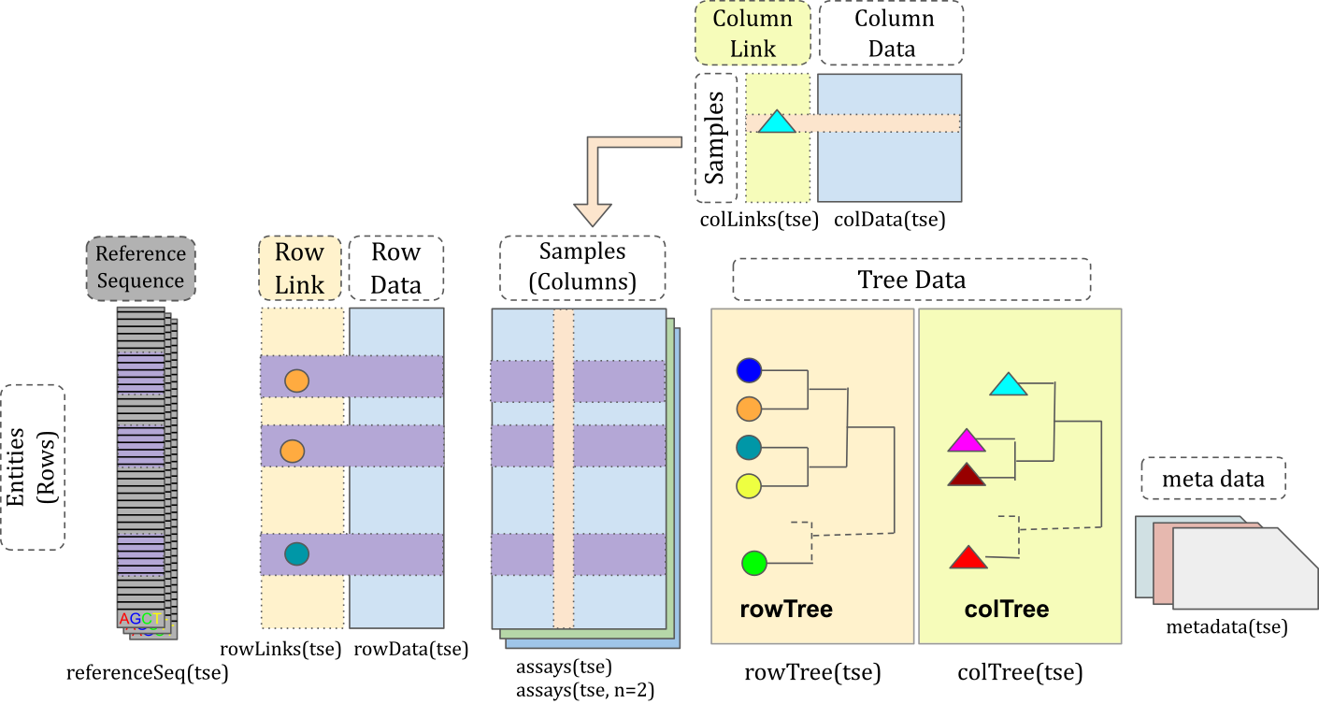
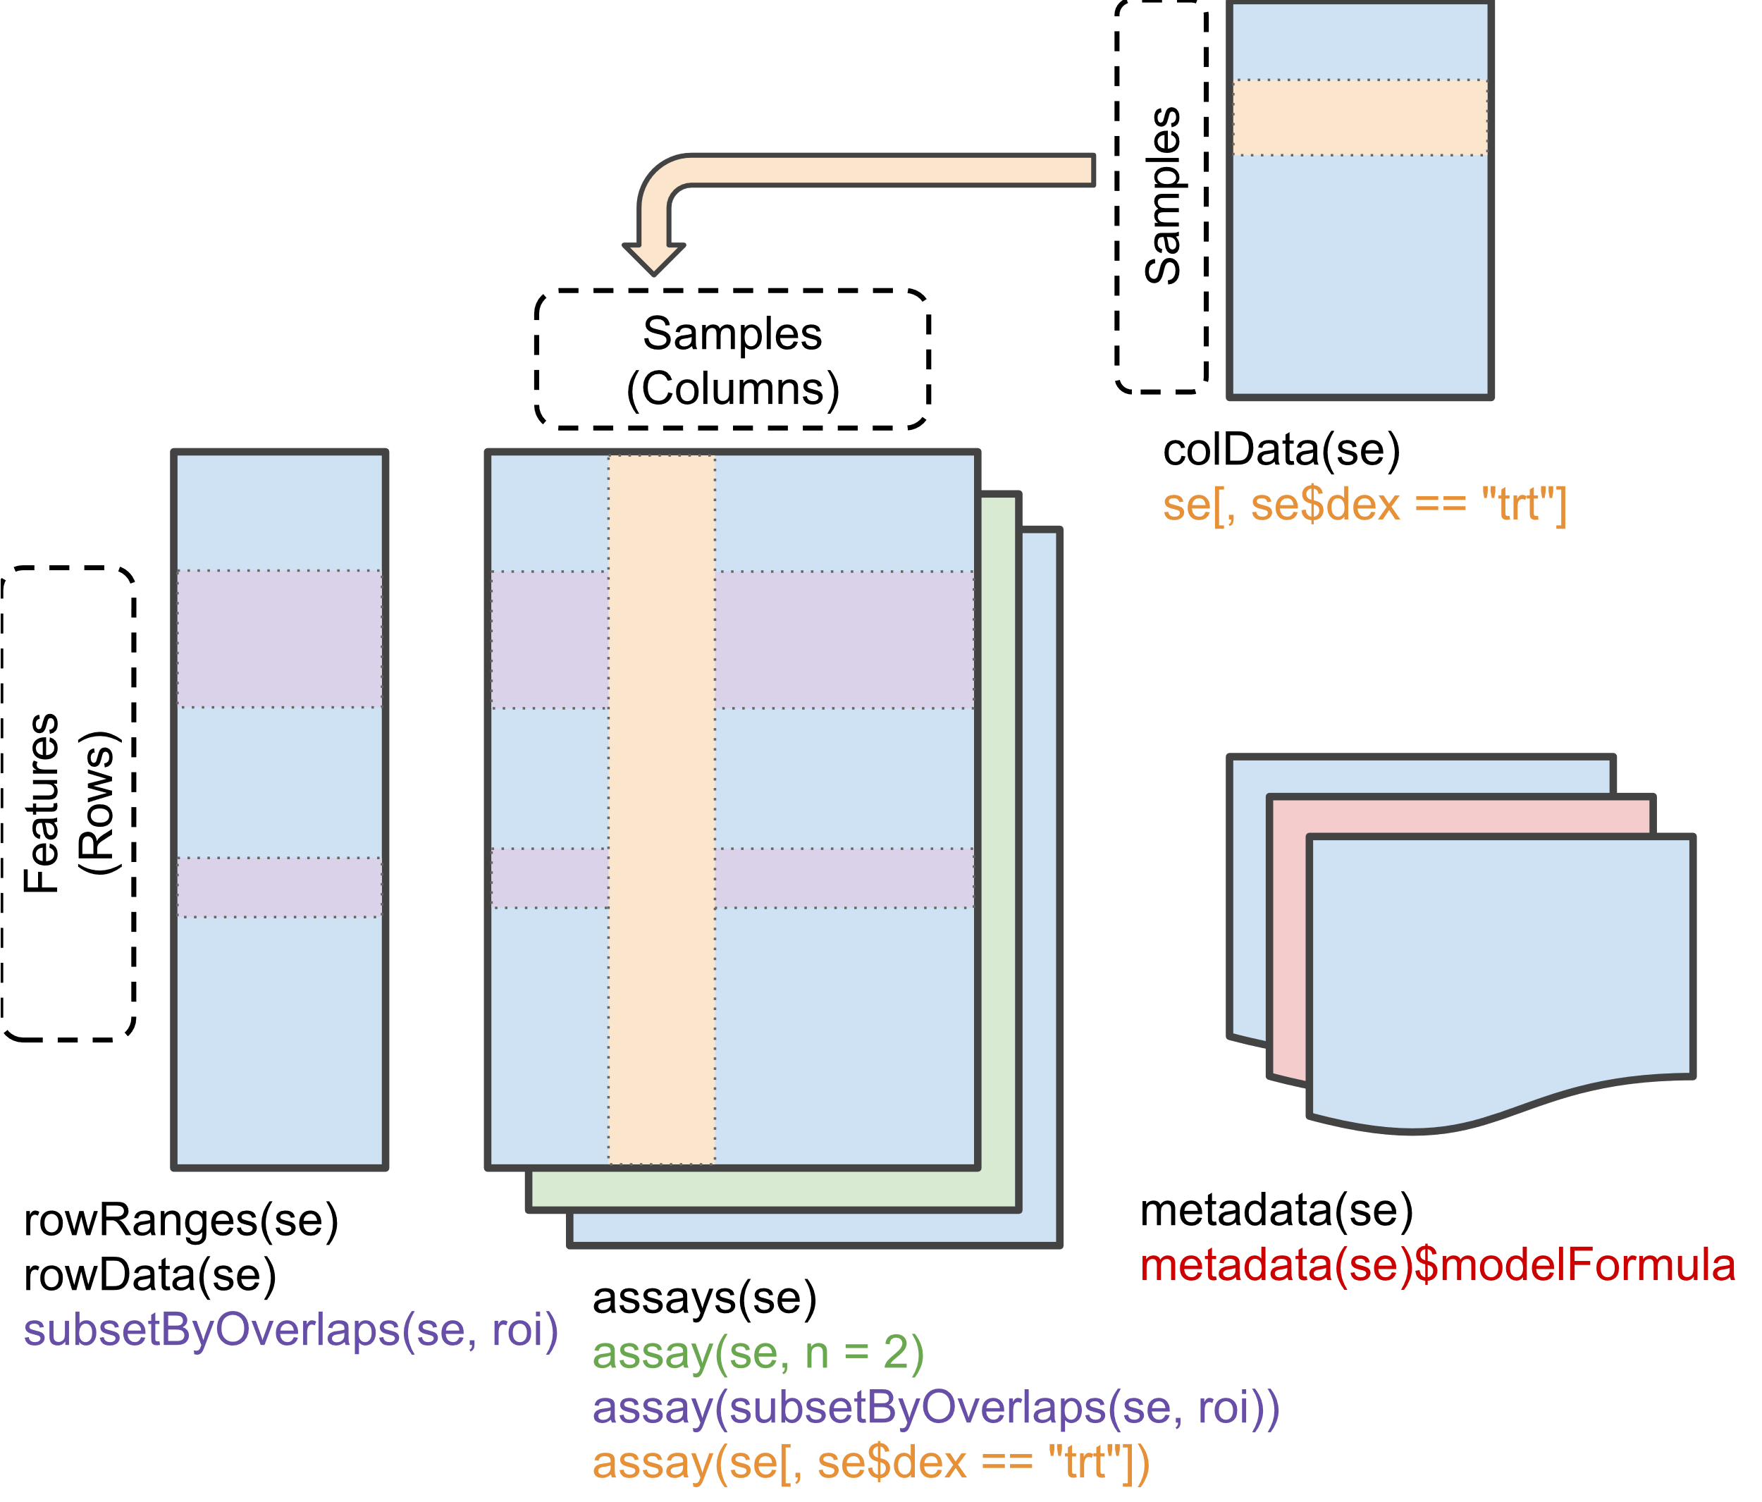
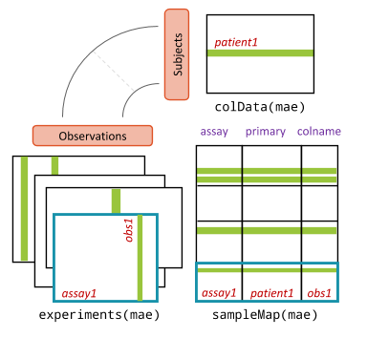
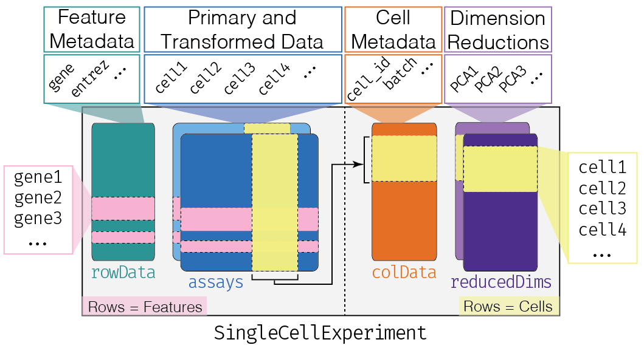
Data containers
TreeSummarizedExperiment
SummarizedExperiment
SingleCellExperiment
MultiAssayExperiment

Slide 2
Data containers
TreeSummarizedExperiment
(Huang et al. 2021)
- taxonomic profiles
- many taxonomic levels
- multiple assays
- functional predictions
- (hierarchical) sample info
- (hierarchical) feature info
- sequence information
- experiment metadata
MultiAssayExperiment
(Ramos et al. 2017)
integrating multiple omics
- taxonomic profiling
- metabolome
- transcriptome
- host genome, exome
- etc.

Slide 3
DADA2
Phyloseq
QIIME2
Mothur
mia
curatedMetagenomicData
Data loading
Taxonomic data
Transformation
microbiomeDataSets
makeTreeSummarizedExperiment*()
loadFromBiom()
loadFromQIIME2()
taxonomyRanks(); checkTaxonomy()
addTaxonomyTree()
IdTaxaToDataFrame()
transformCounts()
ZTransform()
relAbundanceCounts()
Agglomeration
Utilities
Diversity indices
miaTime
agglomerateByRank()
mergeRows(); mergeCols()
splitByRanks()
summary()
countDominantTaxa()
meltAssay()
get*(); subset*()
estimateDiversity(); estimateFaith()
estimateEvenness()
calculateUniFrac(); calculateJSD()
calculateDPCoA()
miaViz
IdTaxa
miaverse
curatedMetagenomicData

Slide 4
DADA2
Phyloseq
QIIME2
Mothur
Others..
mia
curatedMetagenomicData
Data loading
Taxonomic data
microbiomeDataSets
makeTreeSummarizedExperiment*()
loadFromBiom()
loadFromQIIME2()
taxonomyRanks(); checkTaxonomy()
addTaxonomyTree()
IdTaxaToDataFrame()
Agglomeration
Utilities
miaTime
agglomerateByRank()
mergeRows(); mergeCols()
splitByRanks()
summary()
countDominantTaxa()
meltAssay()
get*(); subset*()
miaViz
Transformation
Diversity indices
transformCounts()
ZTransform()
relAbundanceCounts()
estimateDiversity(); estimateFaith()
estimateEvenness()
calculateUniFrac(); calculateJSD()
calculateDPCoA()
IdTaxa
miaverse
curatedMetagenomicData

Slide 5
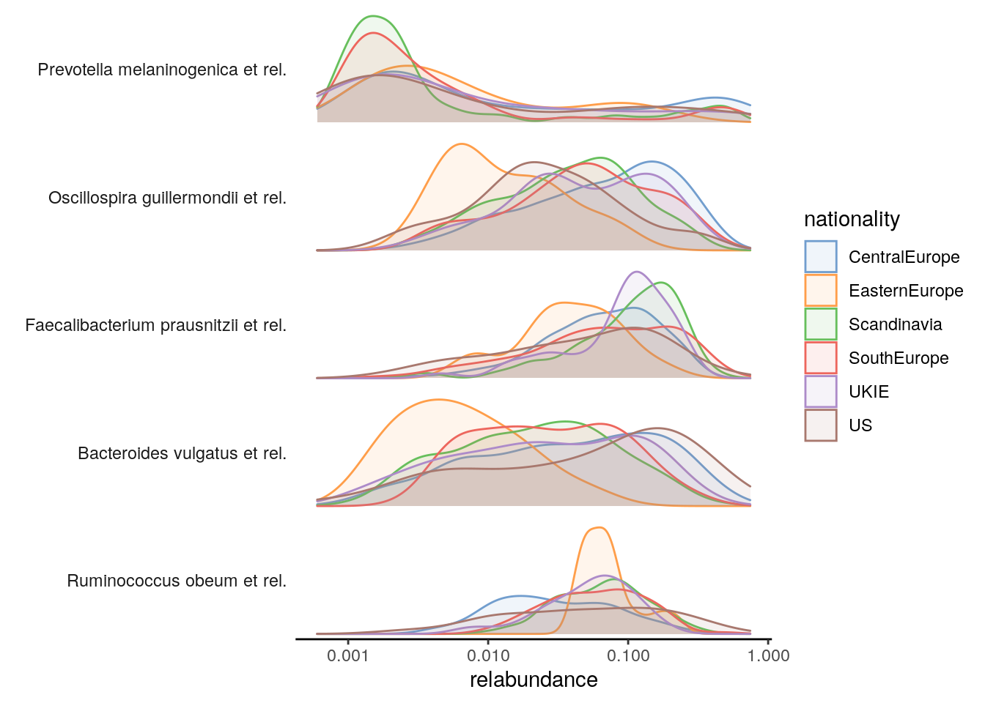
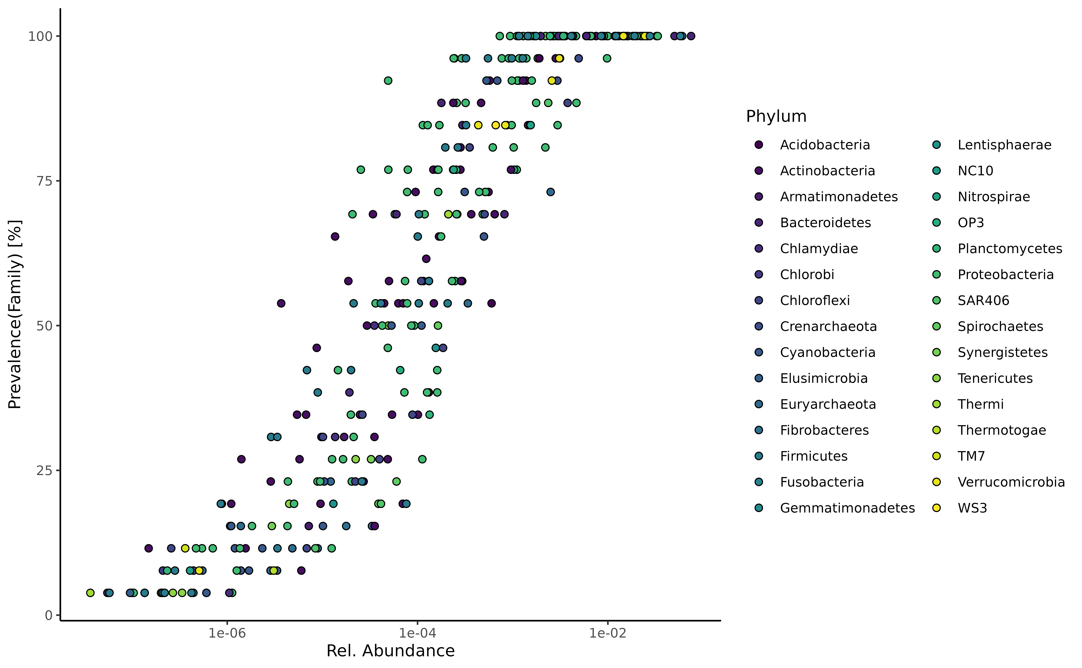
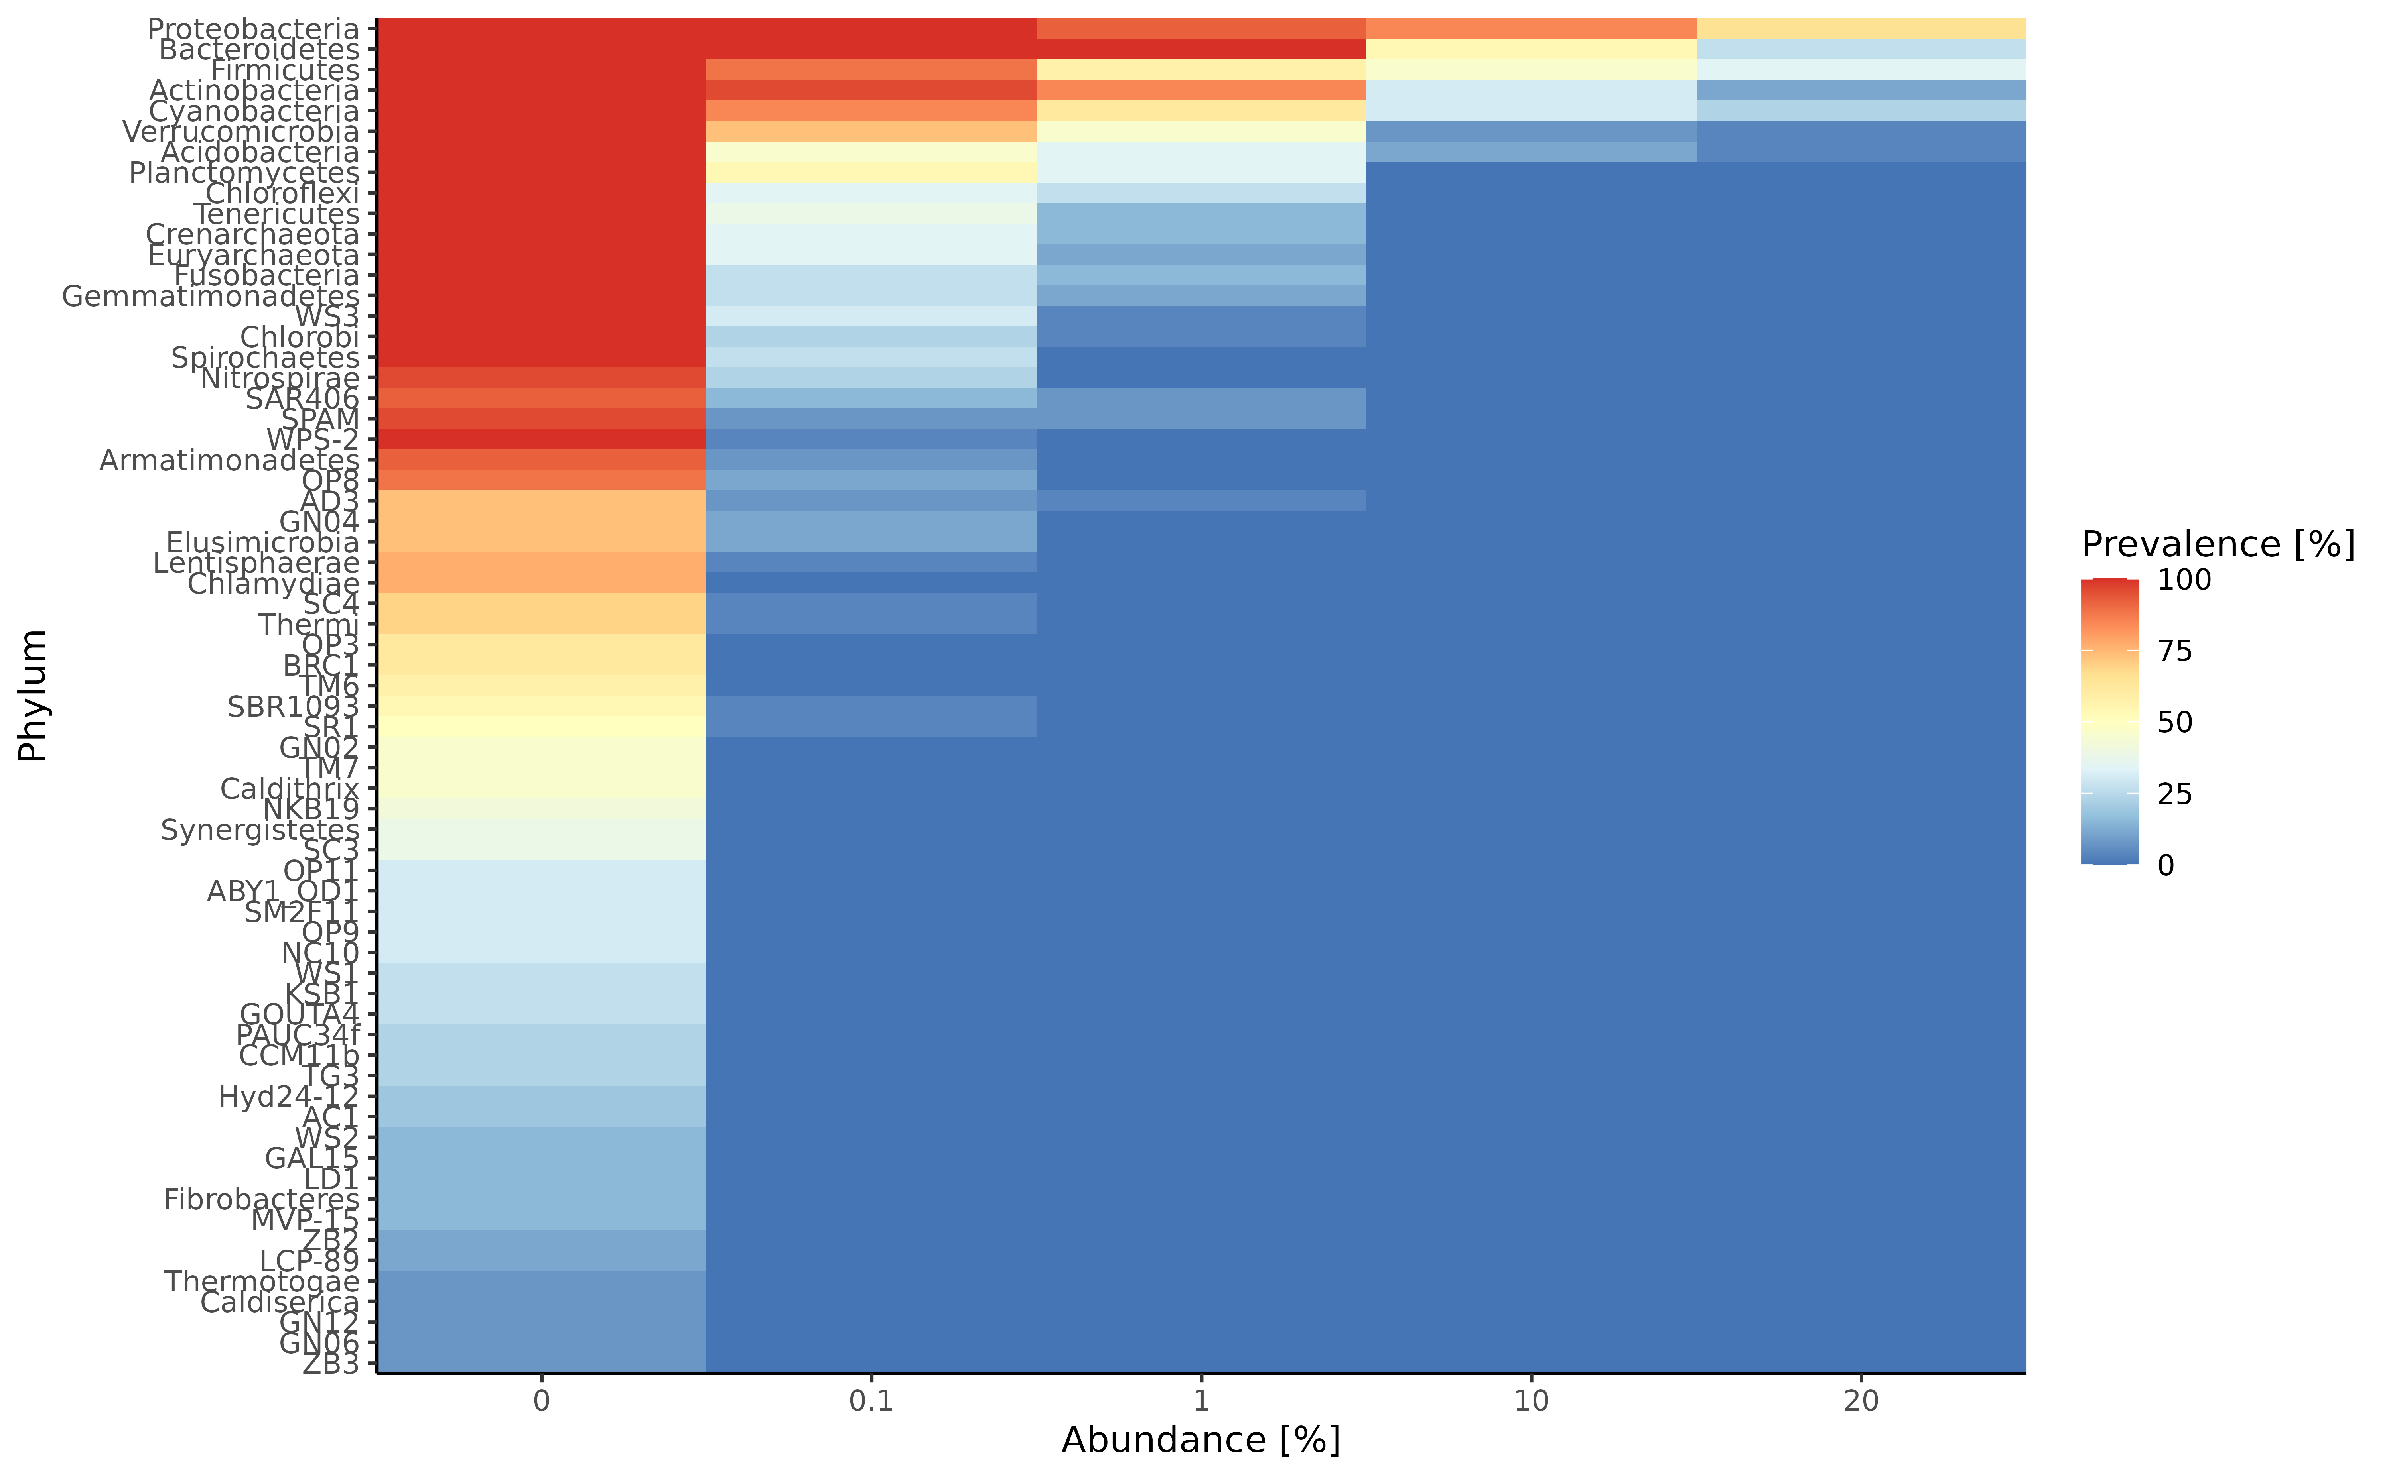
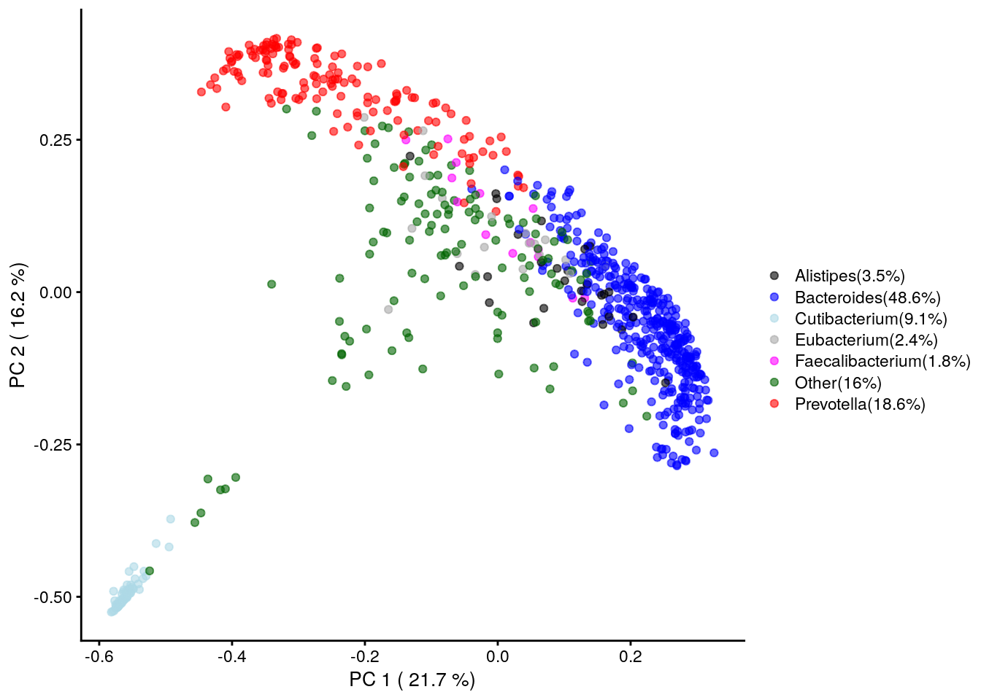
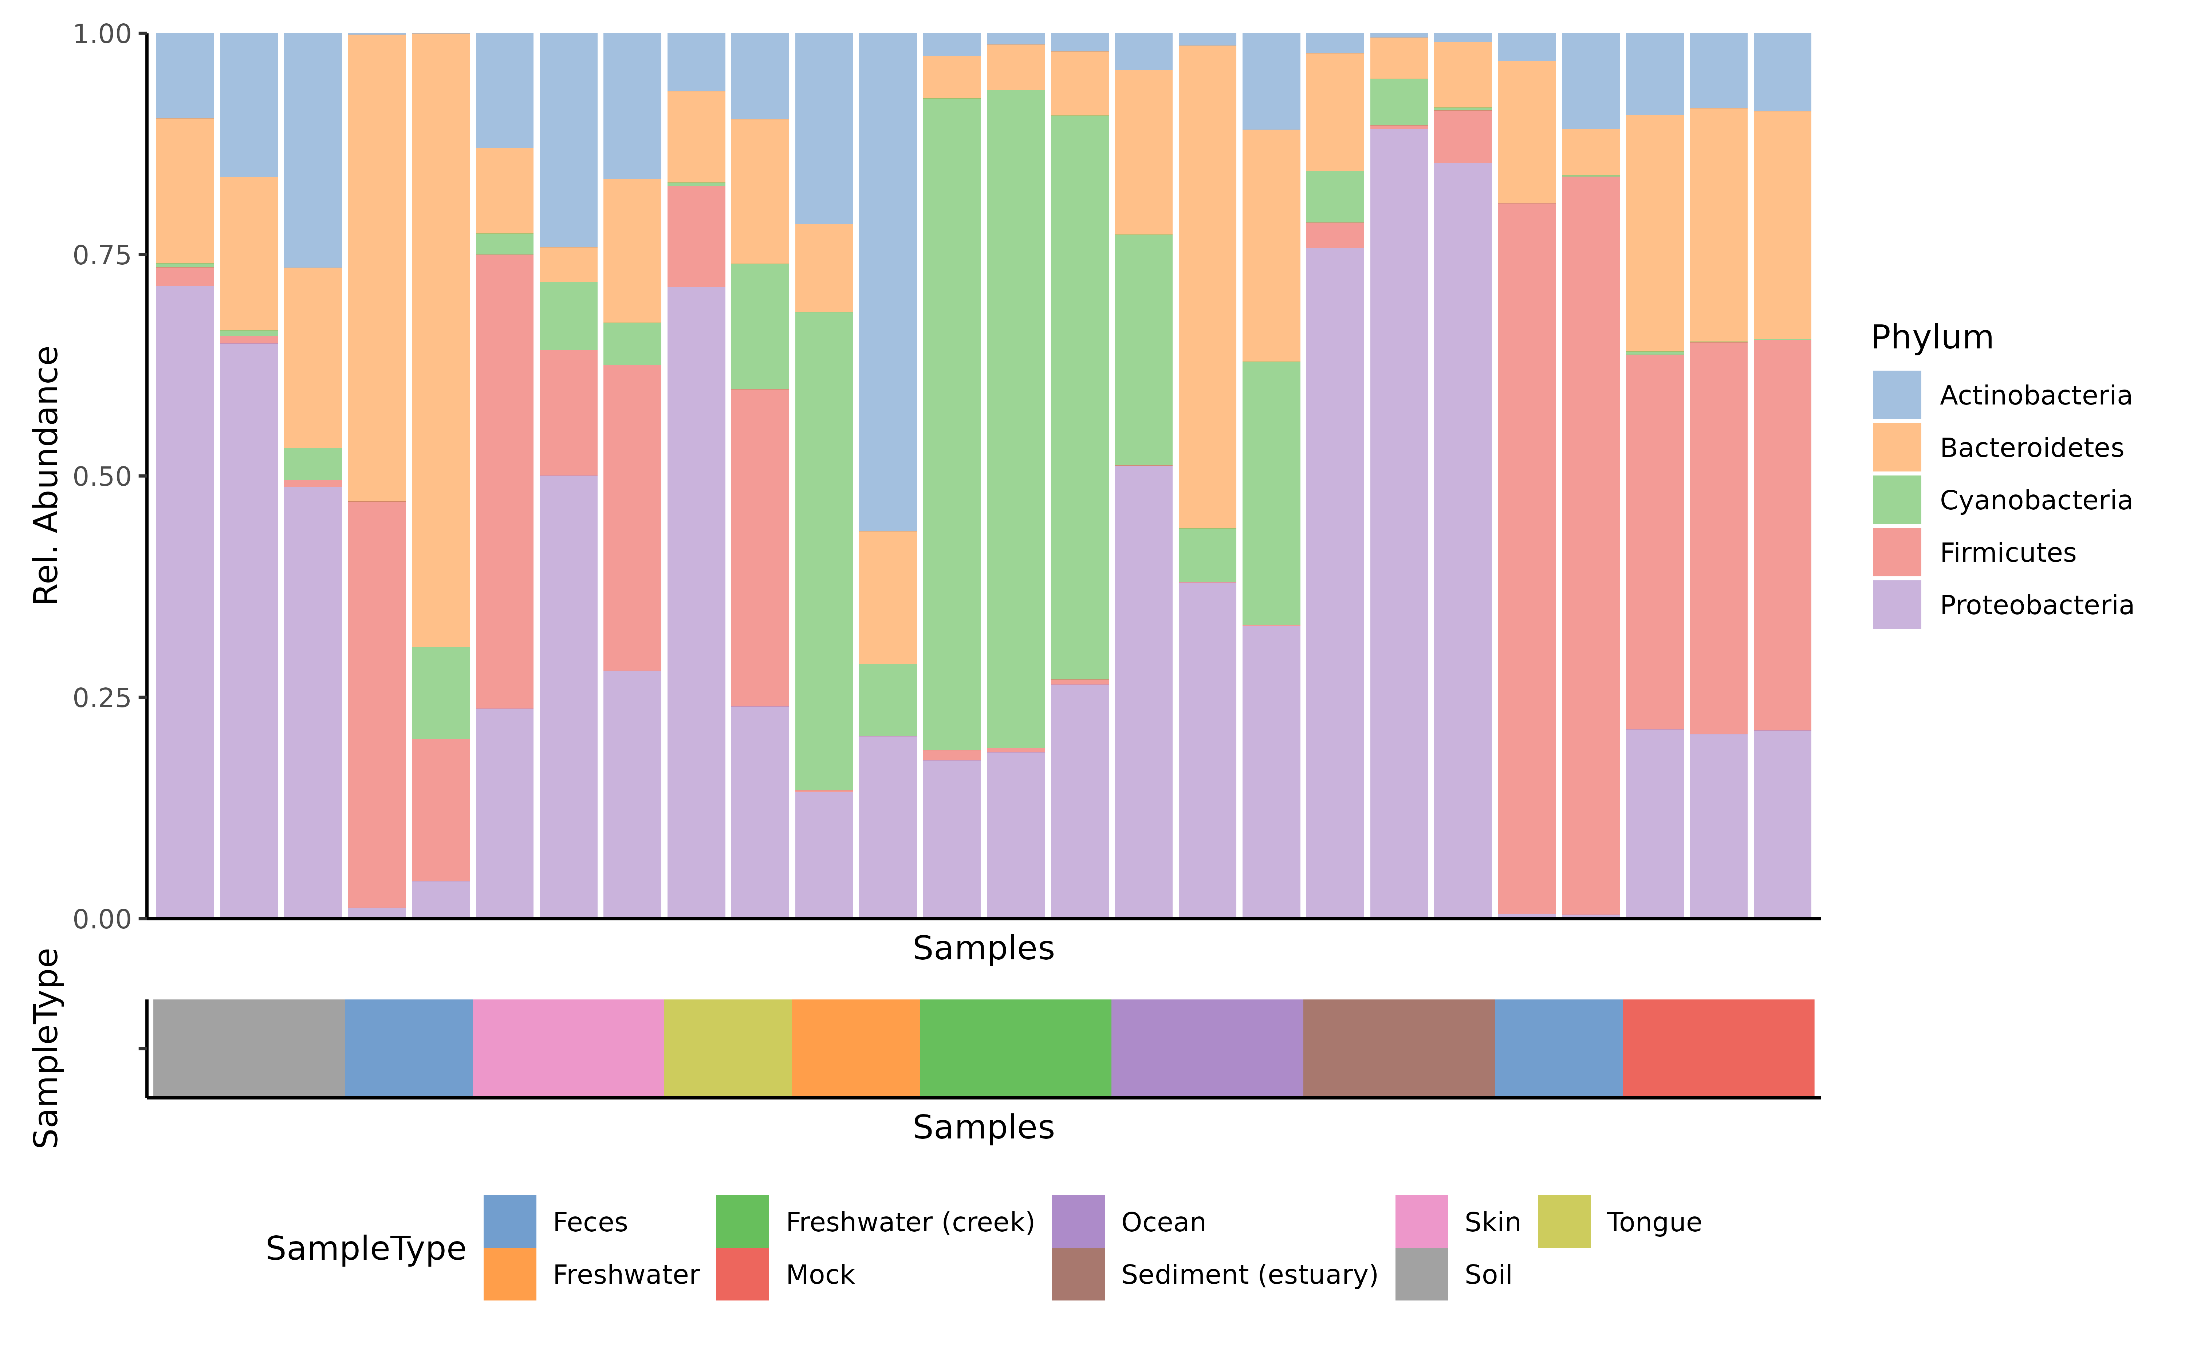
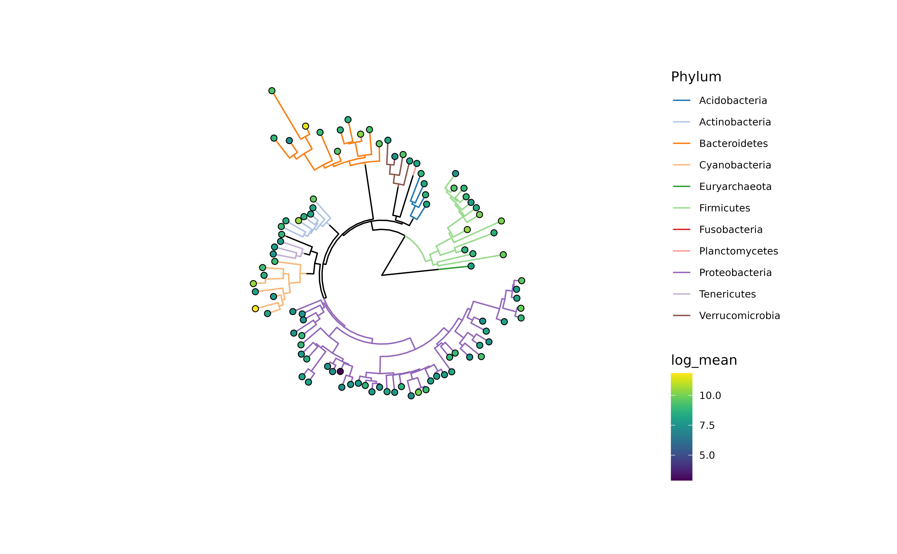
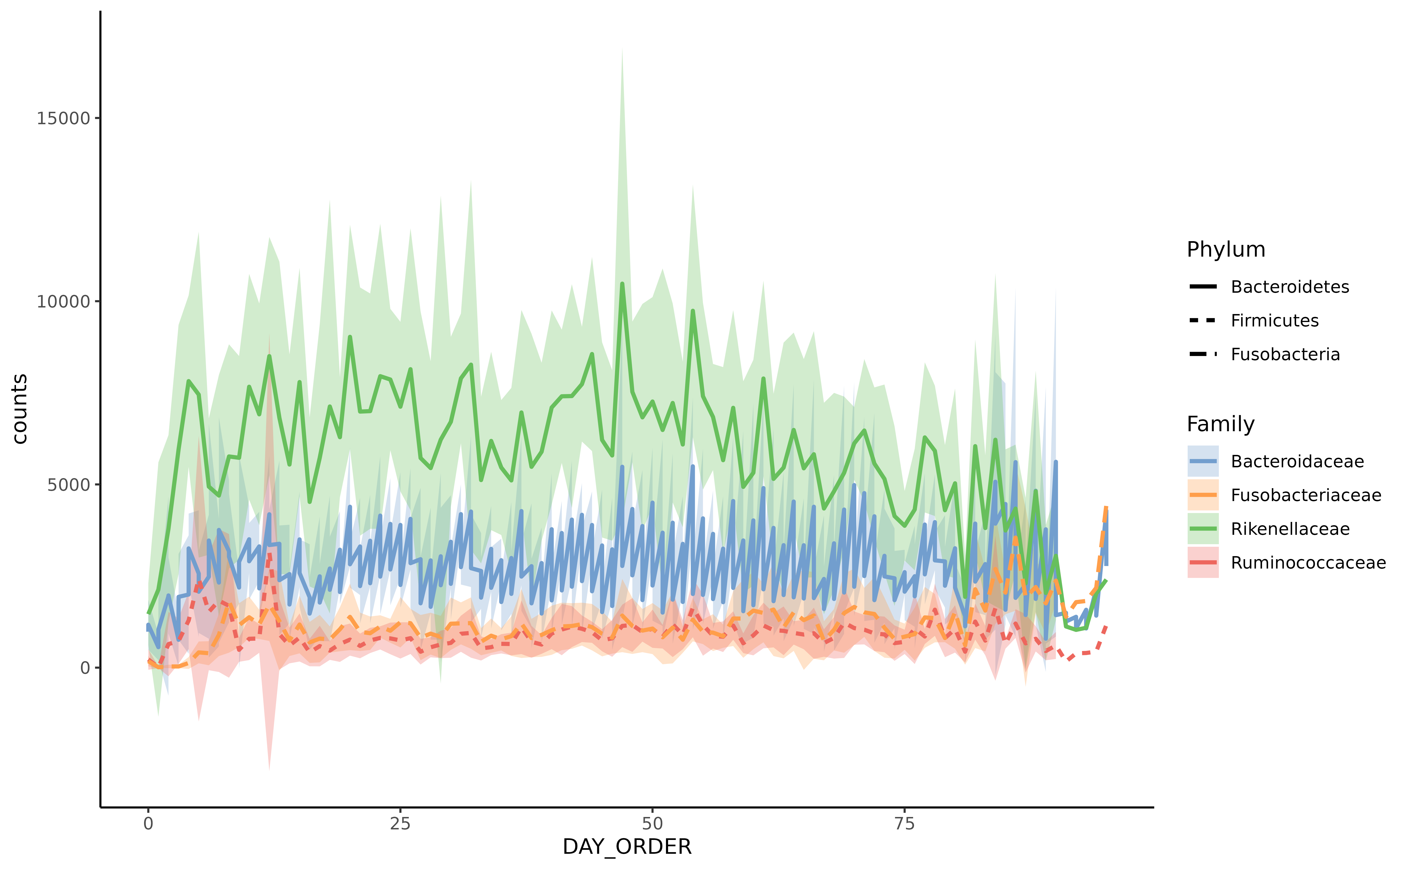
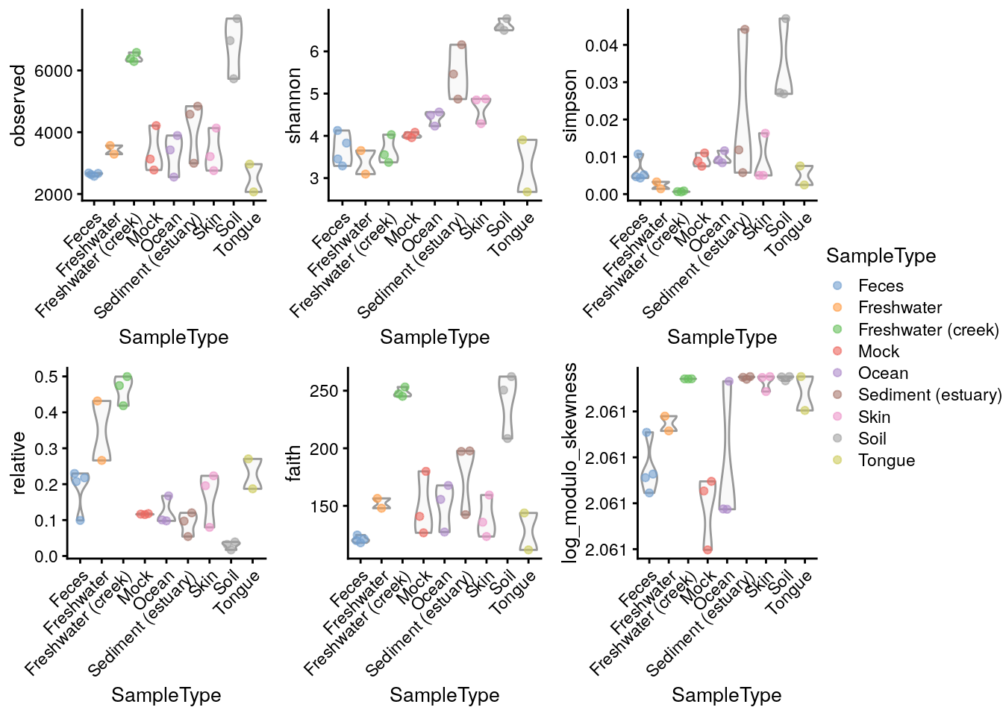
Taxonomic data
Density plot
miaViz
plotAbundanceDensity()
plotPrevalentAbundance()
plotTaxaPrevalence()
scater::plotReducedDim()
plotAbundance()
plotRowTree()
plotSeries()
scater::plotColData()

Slide 6
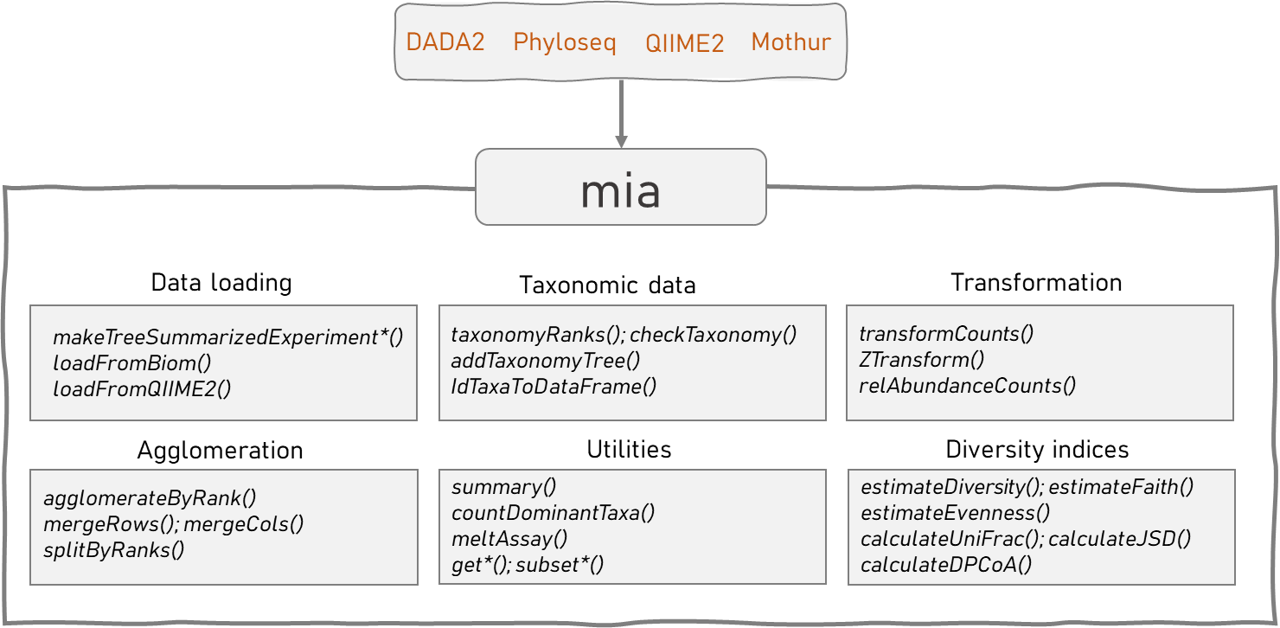


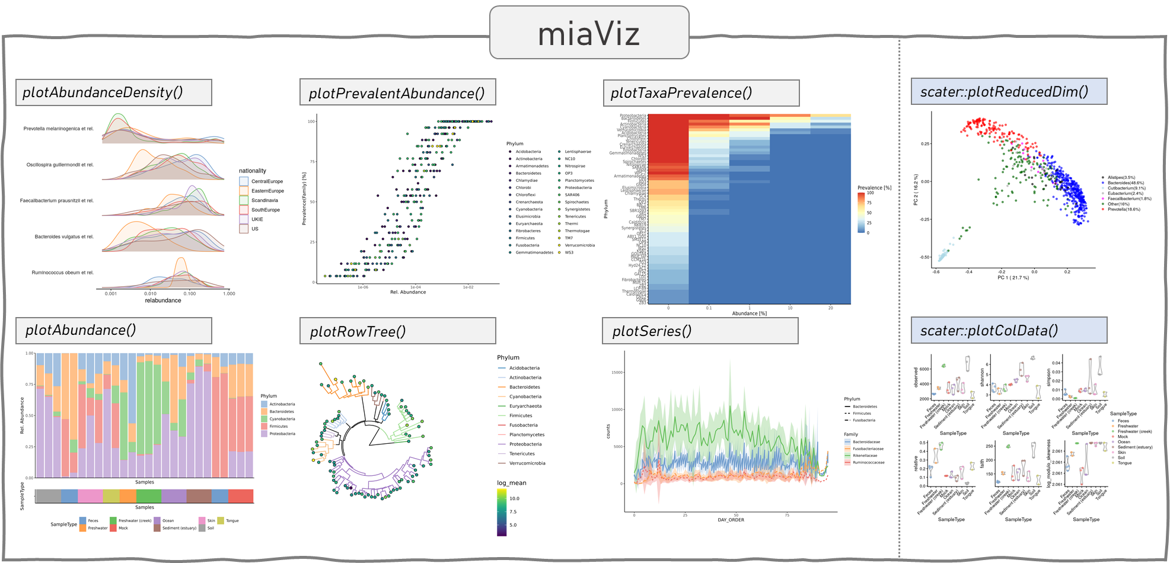

Slide 7
curatedMetagenomicData
curatedMetagenomicData
SE source: https://www.bioconductor.org/packages/devel/bioc/vignettes/SummarizedExperiment/inst/doc/SummarizedExperiment.html
MAE source:
https://waldronlab.io/MultiAssayWorkshop/articles/Ramos_MultiAssayExperiment.html
SCE source:
http://bioconductor.org/books/3.13/OSCA.intro/the-singlecellexperiment-class.html

Slide 8



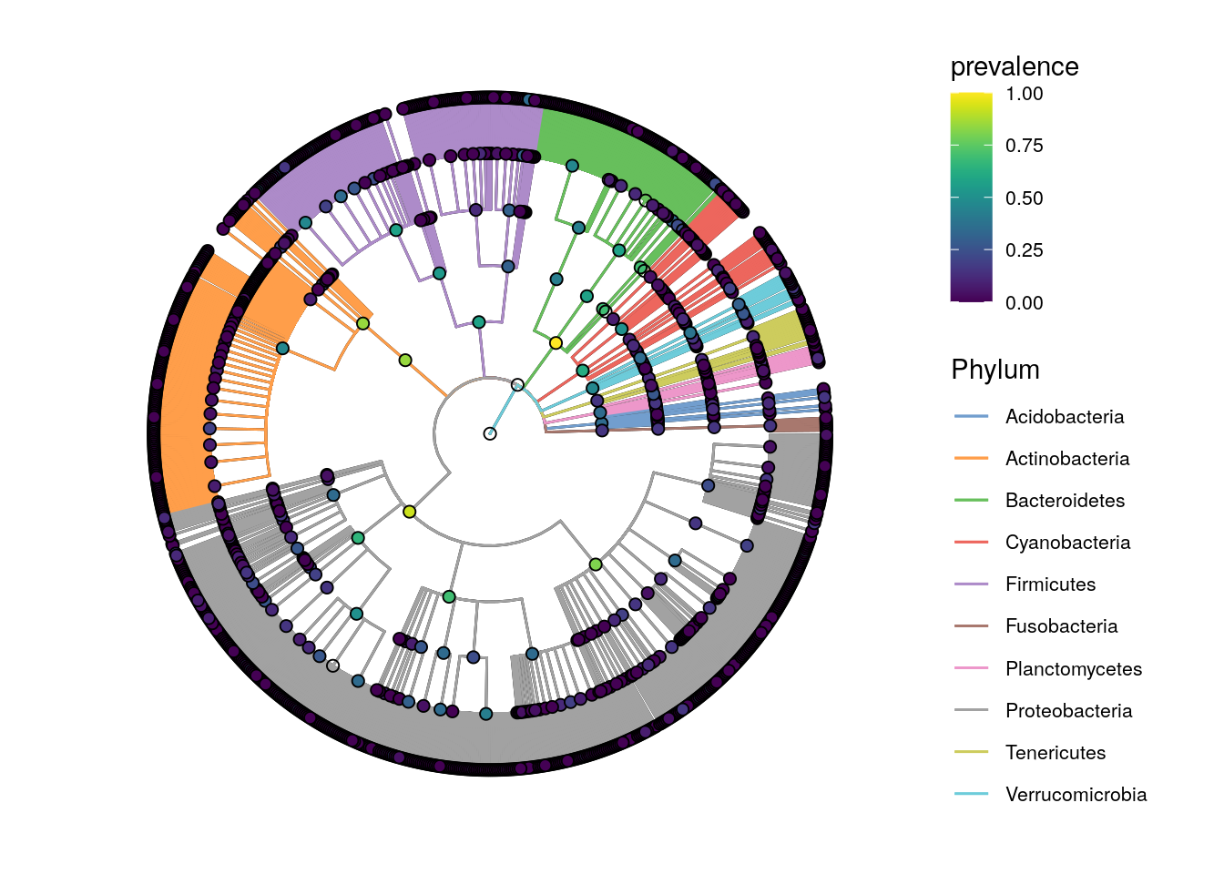

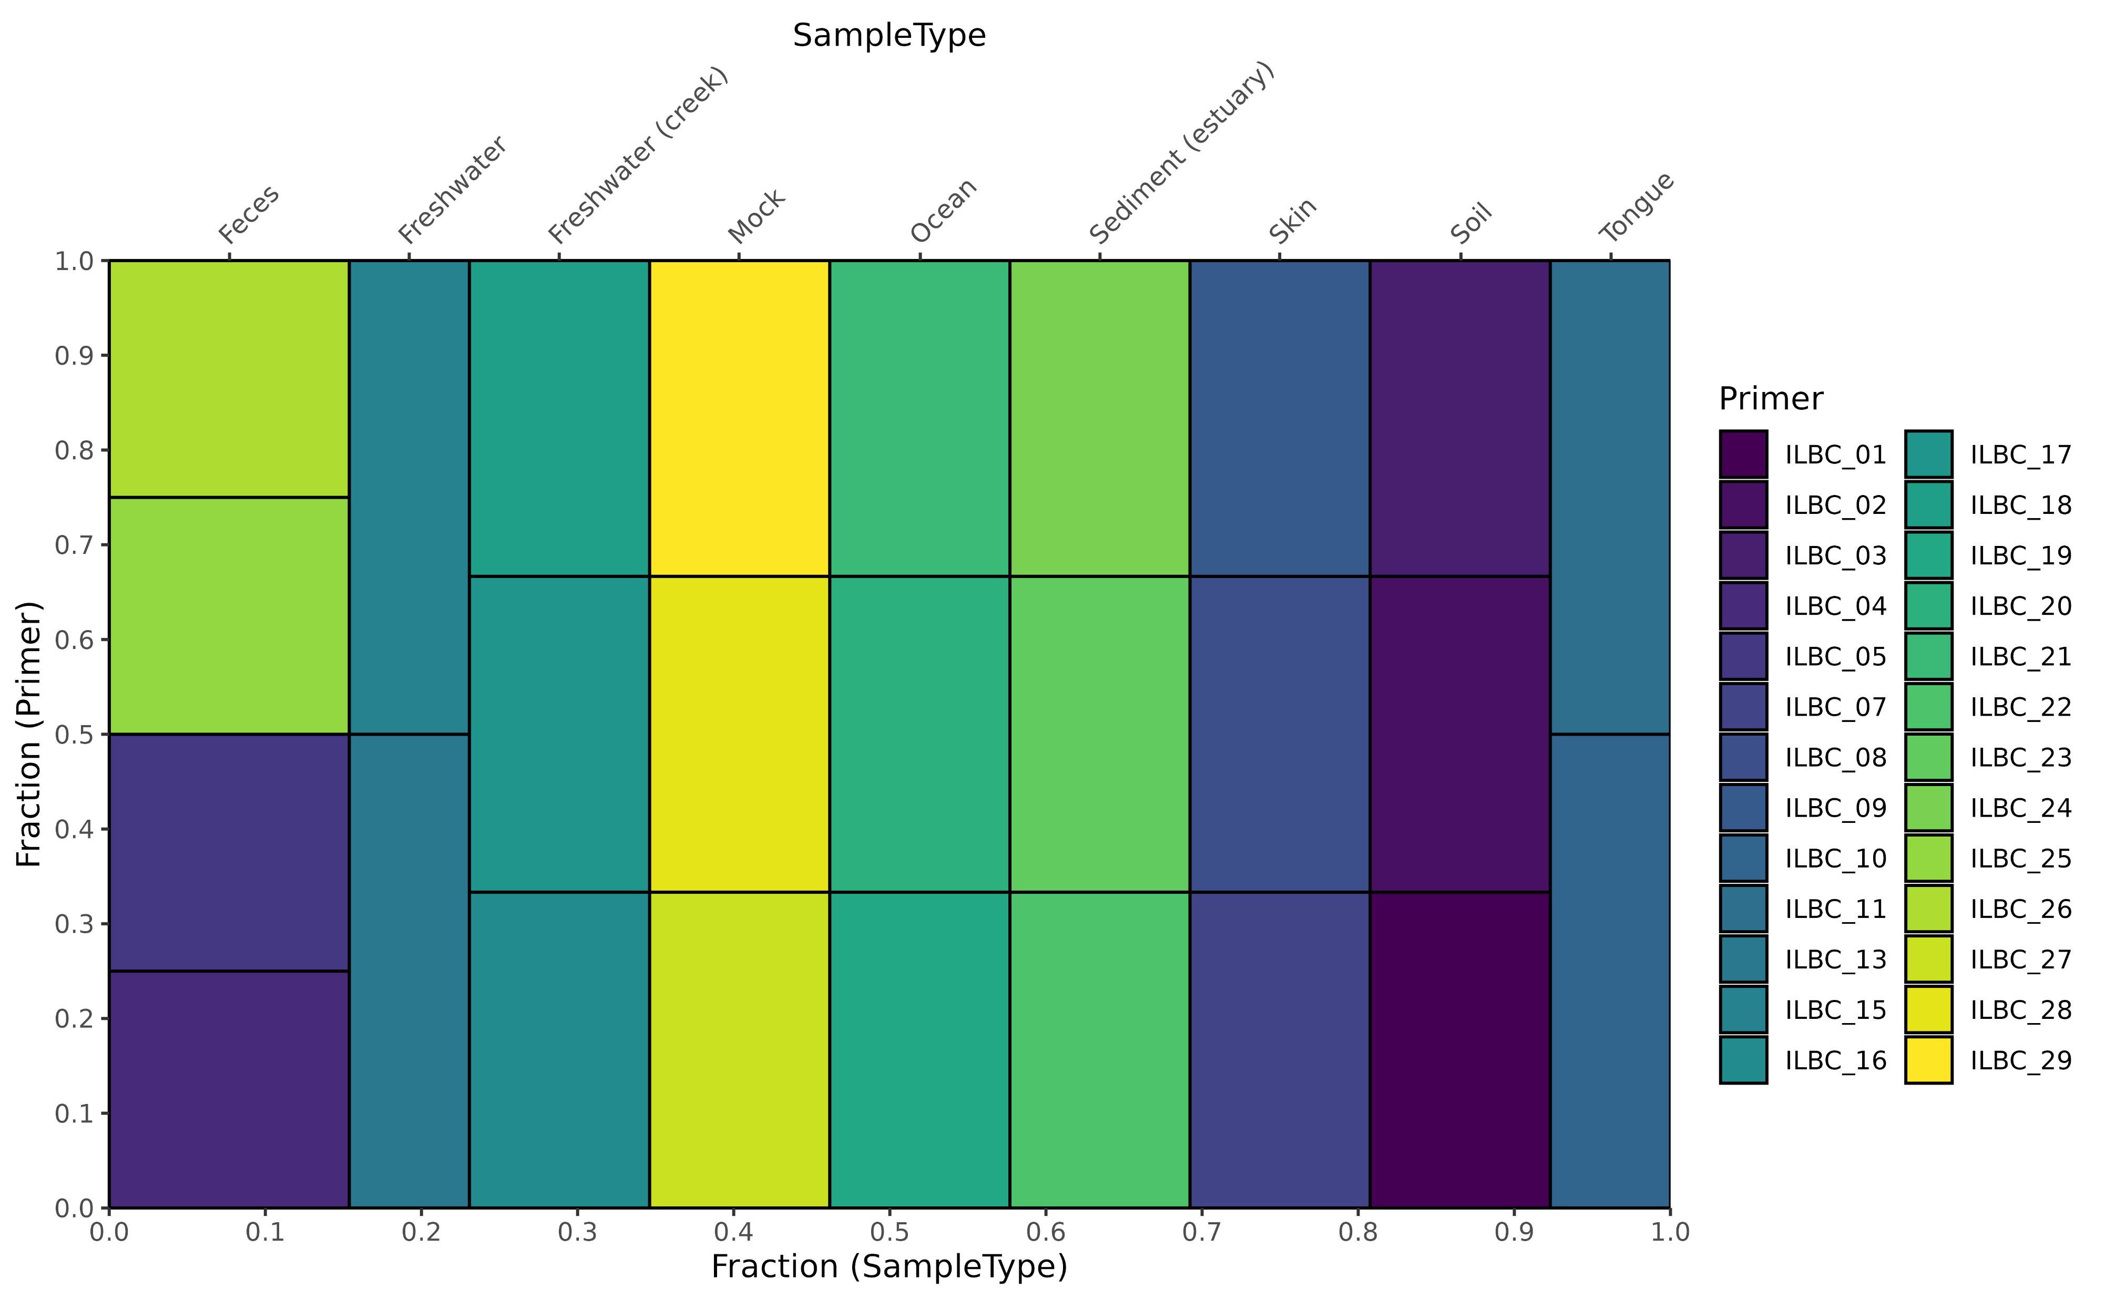
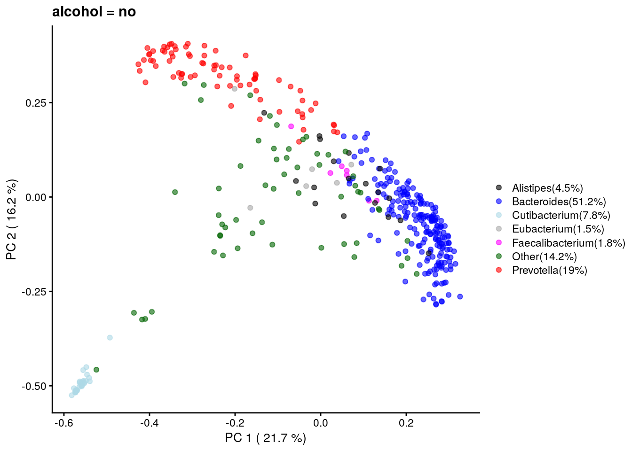
miaViz
plotAbundanceDensity()
plotPrevalentAbundance()
plotTaxaPrevalence()
plotAbundance()
plotRowTree()
plotSeries()
plotColTile()
scater::plotReducedDim()
scater::plotColData()

Slide 9
microbiomeDataSets
TreeSummarizedExperiment MultiAssayExperiment
availableDataSets()

Slide 10
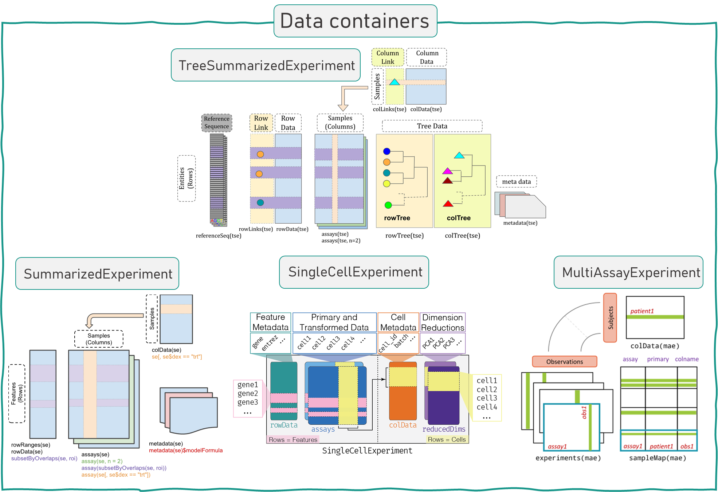
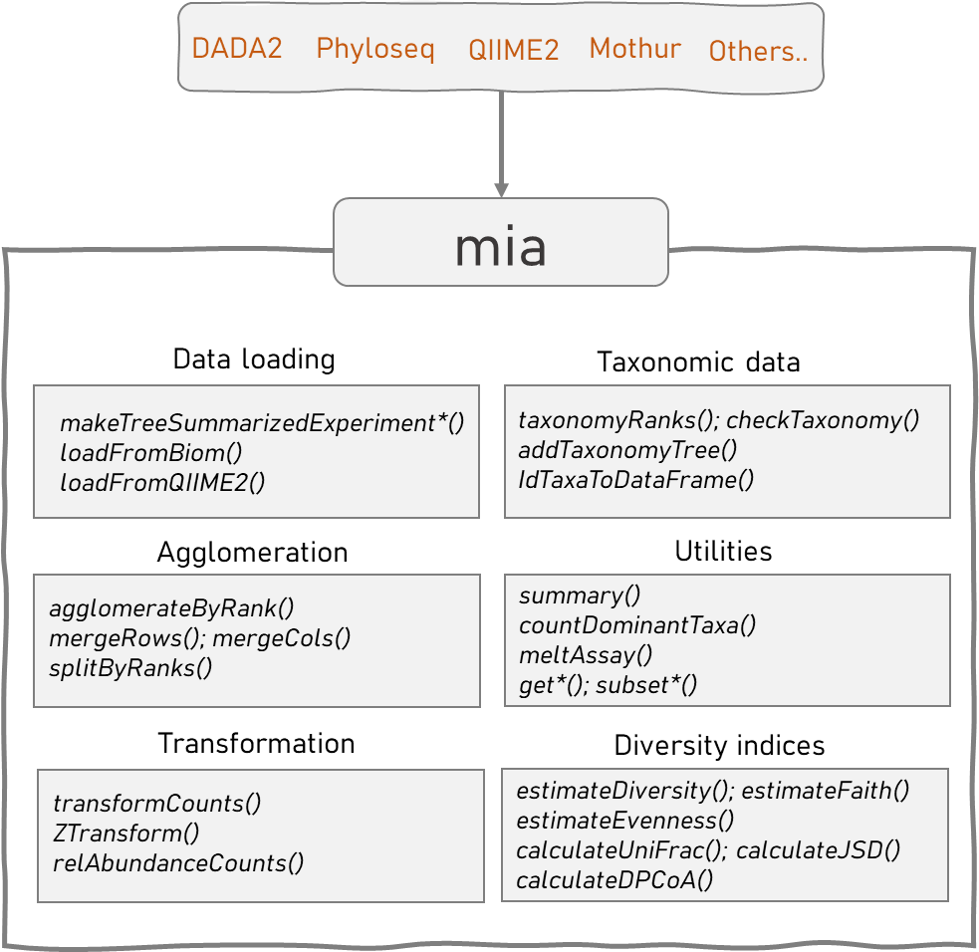
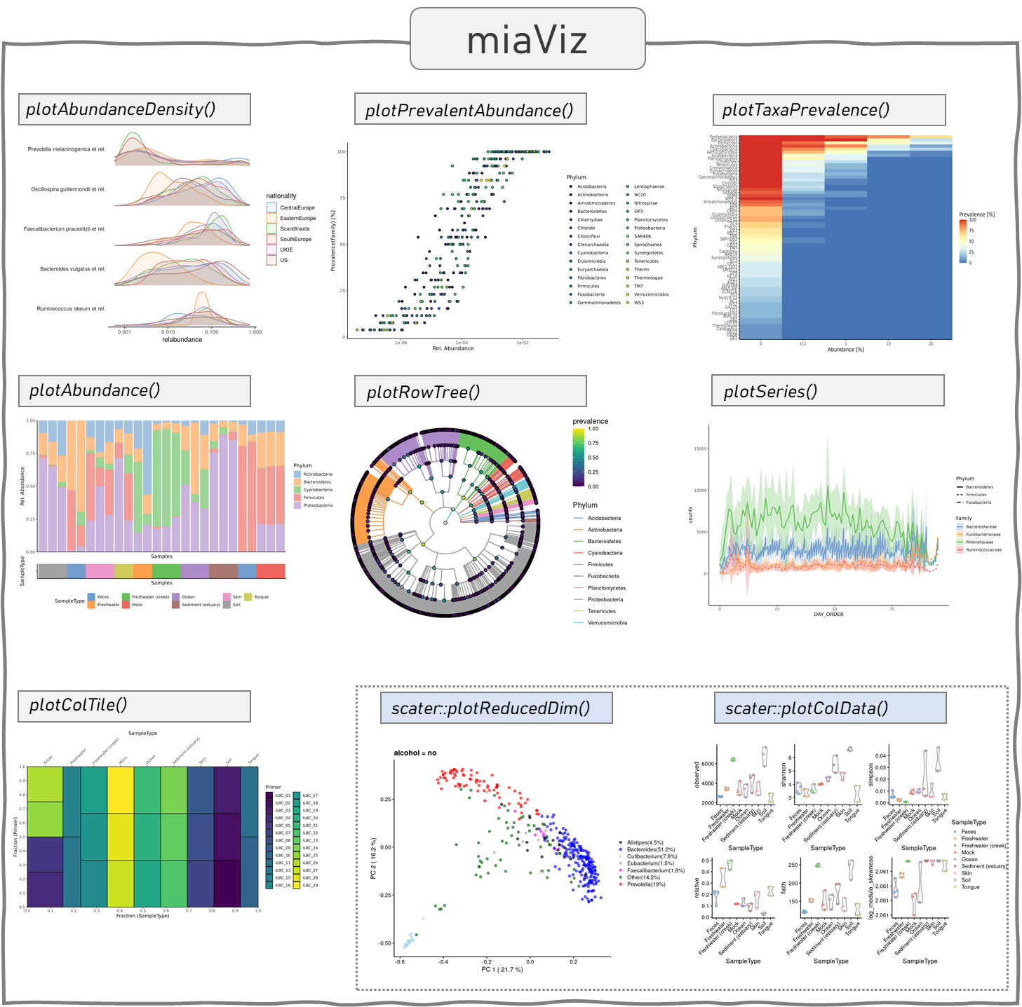
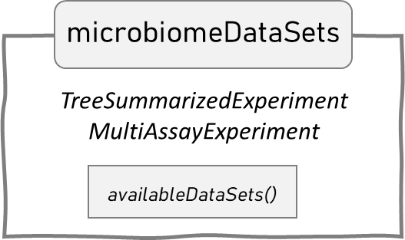
curatedMetagenomicData
TreeSE image source: https://f1000research.com/slides/9-1464
SE image source: https://www.bioconductor.org/packages/devel/bioc/vignettes/SummarizedExperiment/inst/doc/SummarizedExperiment.html
MAE image source: https://waldronlab.io/MultiAssayWorkshop/articles/Ramos_MultiAssayExperiment.html
SCE s image source: http://bioconductor.org/books/3.13/OSCA.intro/the-singlecellexperiment-class.html

